Slide 1
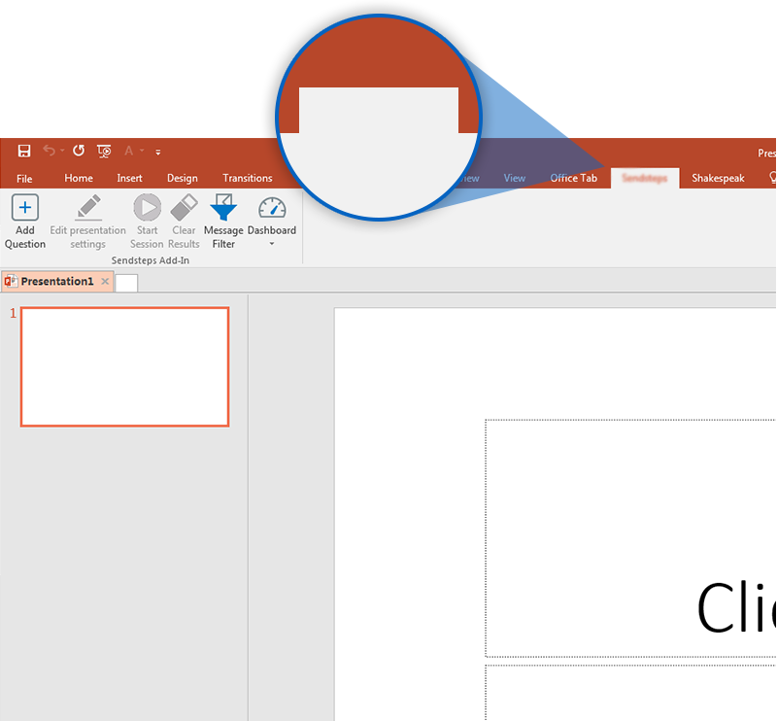

NEXT STEP: CLICK ON THE K4VOTE TAB!
k4vote
Click on the k4vote tab to make your presentation interactive and give your audience a voice.
For more info go to your Dashboard

