Slide 1


Getting started
Powered by
Learn how to:
Ask your audience multiple choice questions
Ask your audience open questions
Change settings of your interactive presentation
… start your session!

Slide 2
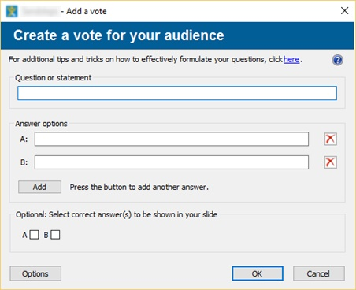

Powered by
VOTING
Add a question to your presentation
1. Click the new tab added in your top bar
2. Click “Add vote slide”
A pop-up box will open.
Easily enter your question and answers and finish by clicking “OK”

Slide 3
Powered by
VOTING
Slides are added
3 slides are now added to your presentation:
An explanation slide for your audience
The question and answer slide
The result slide
Do you also like to receive messages from your audience? Proceed to the next slide and get to know how easy this can be done!

Slide 4
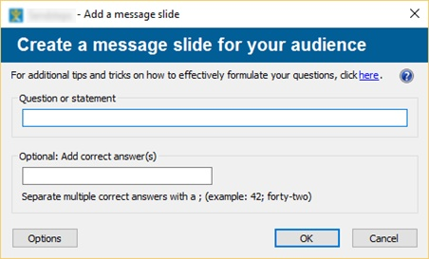
Powered by
RECEIVE MESSAGES
Allow your audience to send messages
1. Click the new tab added in your top bar
2. Click “Add message slide”
A pop-up box will open.
Easily enter your question or statement and finish by clicking “OK”.
Press this button if you would like to filter the incoming messages

Slide 5
Powered by
RECEIVE MESSAGES
A slide is added
One slide is now added to your presentation. This slide carries the question and space for comments.
Are you happy with the questions? Then it’s time to start your session. Proceed to the next slide and start your interactive presentation!

Slide 6
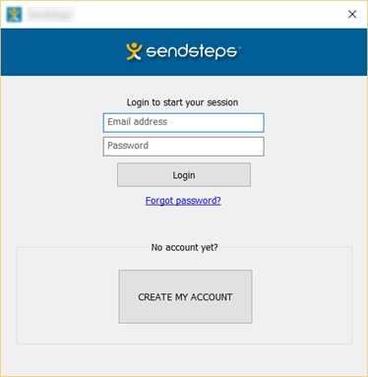
Powered by
READY TO GO?
Start your session!
Click “Start session” and log in or create your account
Start your Slide Show in order to receive responses
Invite your audience to respond via web, SMS or Twitter

Slide 7
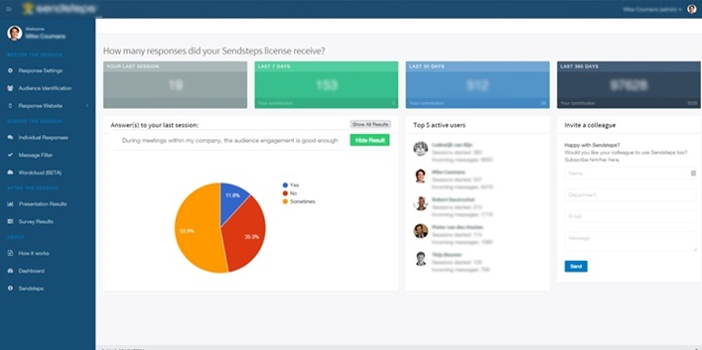
Powered by
DASHBOARD
Change settings, find results and much more in your personal Dashboard
Click “Dashboard”
Your dashboard appears in a webpage: On your dashboard you can change settings before the session, find results during and after the session and many more features!
Questions regarding the add-in? Our team is happy to help you out!

Slide 8

At Sendsteps we believe it is important to foster dialogue during meetings!
Only when everybody is heard, and feels heard, then both individuals and organizations can grow!
We wish you lots of interaction and inspiration!
Thank you for using

