Slide 1
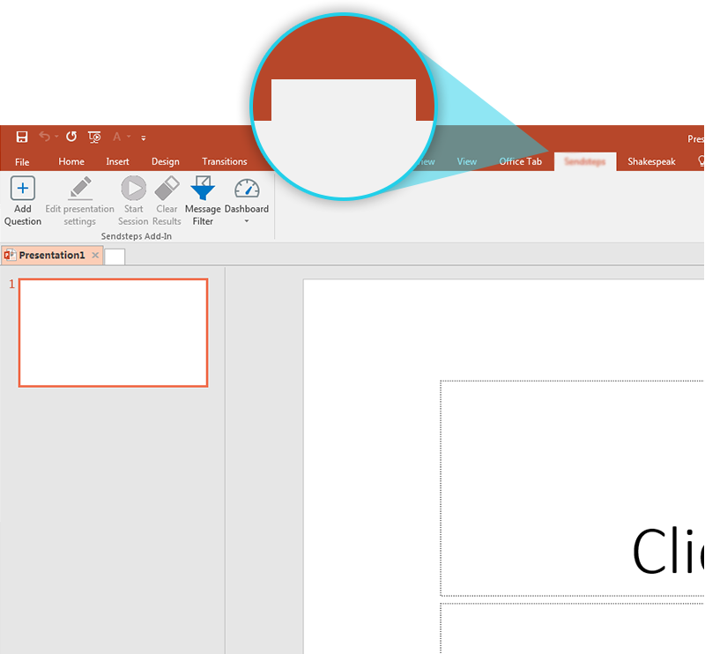
Next step: click on the Vote3M tab!
Vote3M
Click on the Vote3M tab to make your presentation interactive and give your audience a voice.
For more info go to your Dashboard

