Slide 1

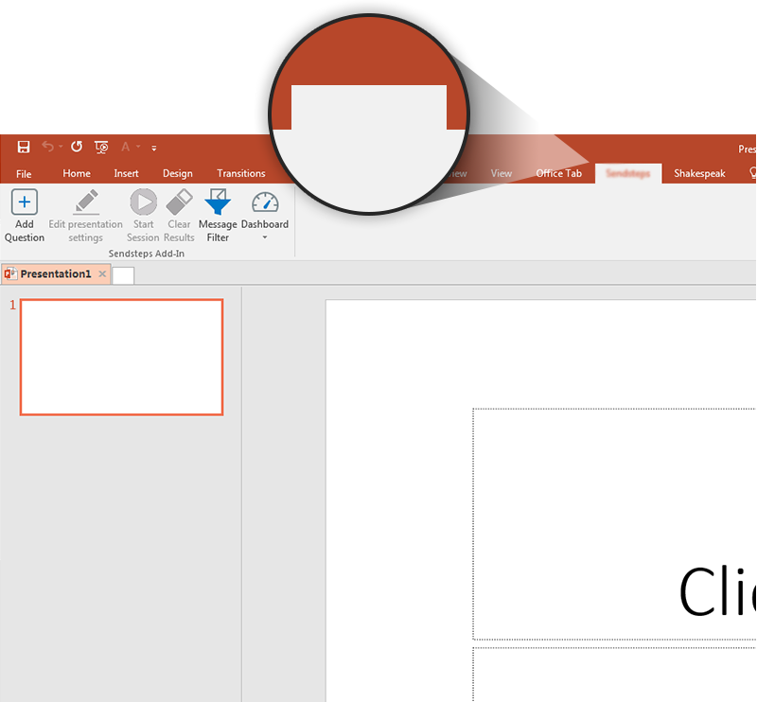

NEXT STEP: CLICK ON THE T-VOTE TAB!
T-Vote
Click on the T-Vote tab to make your presentation interactive and give your audience a voice.
For more info go to your Dashboard

