Slide 1

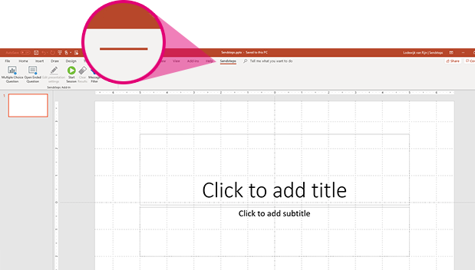
Now you can make an existing or new presentations interactive.
Click on the T-Mobile Vote tab to make your presentation interactive and give your audience a voice.
T-Mobile Vote
For more info go to your Dashboard

