Slide 1
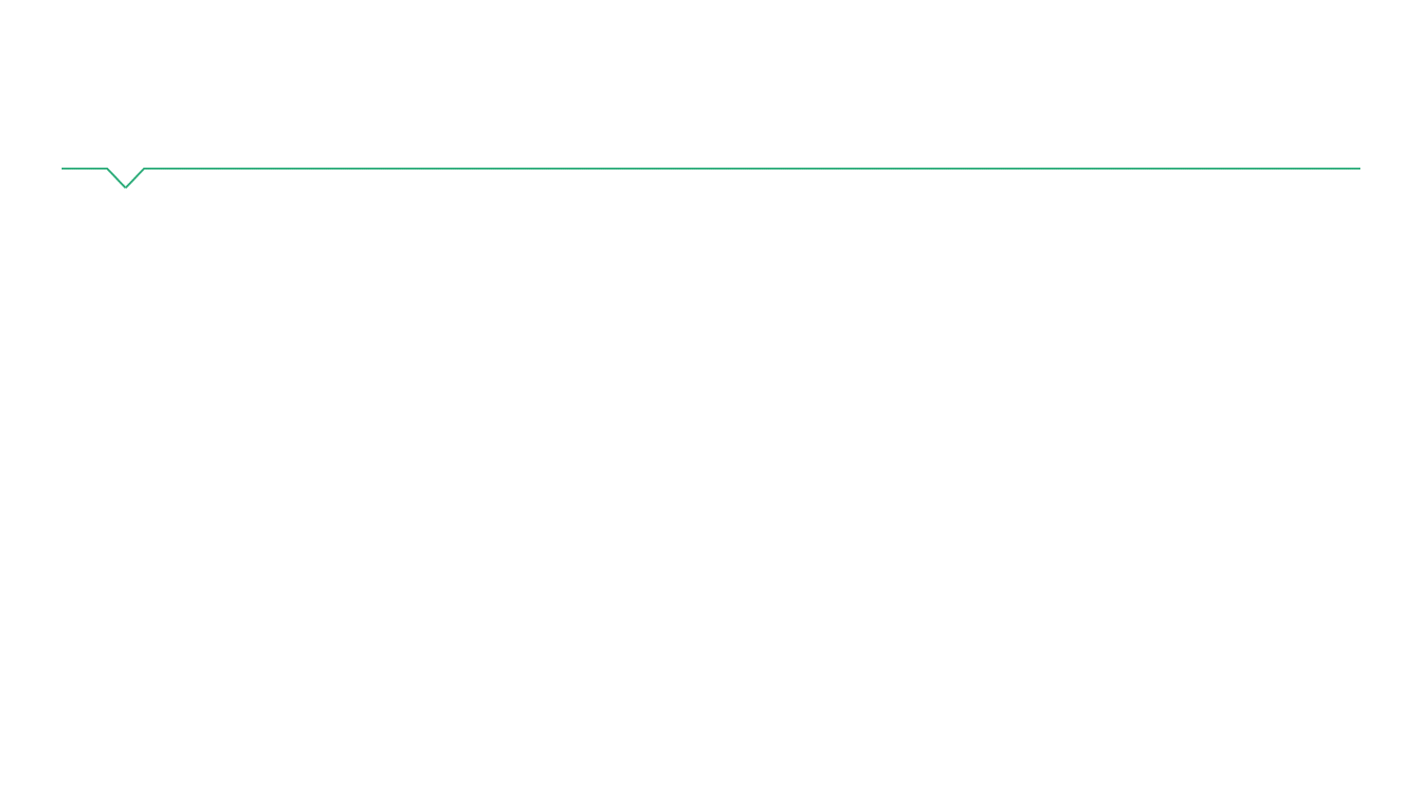
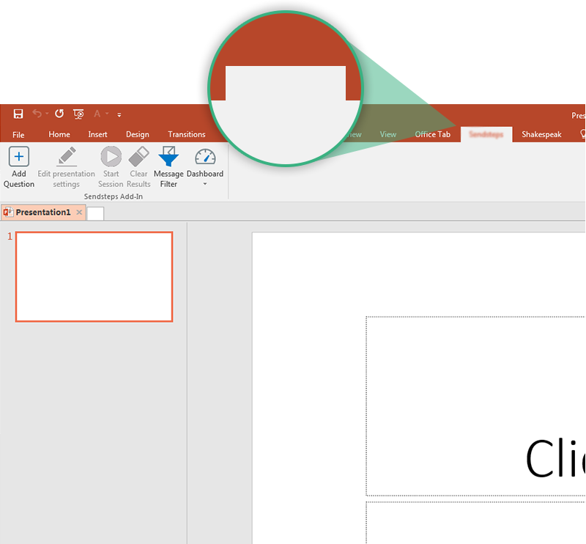
Next step: click on the StibbeVote tab!
StibbeVote
Click on the StibbeVote tab to make your presentation interactive and give your audience a voice.
For more info go to your Dashboard

