Slide 1

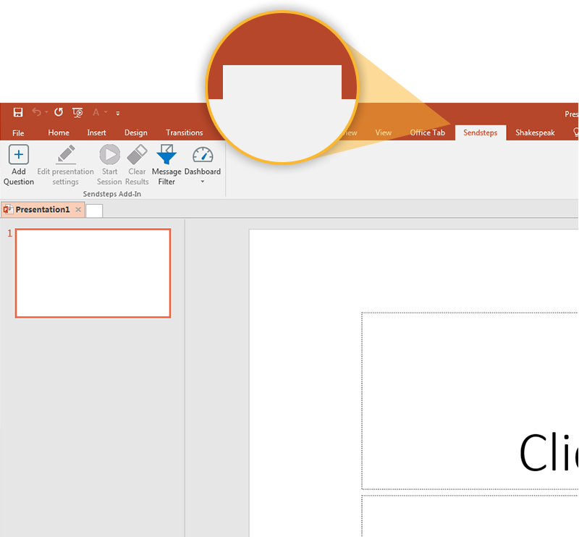

Next step: click on the Shakespeak tab!
Shakespeak
Click on the Shakespeak tab to make your presentation interactive and give your audience a voice.
For more info go to your Dashboard

