Slide 1

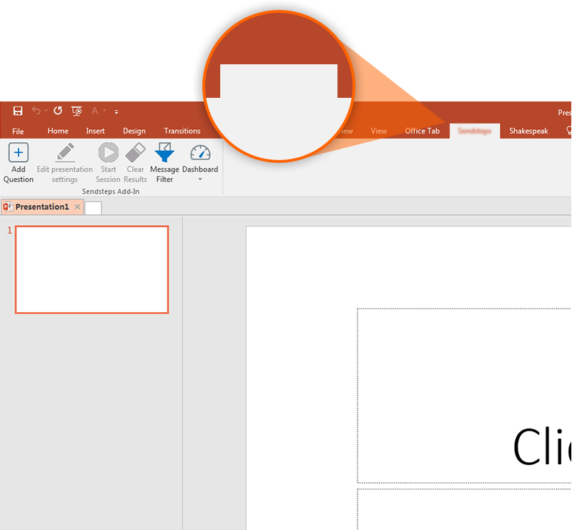
Next step: click on the RaboVote tab!
RaboVote
Click on the RaboVote tab to make your presentation interactive and give your audience a voice.
For more info go to your Dashboard

