Slide 1

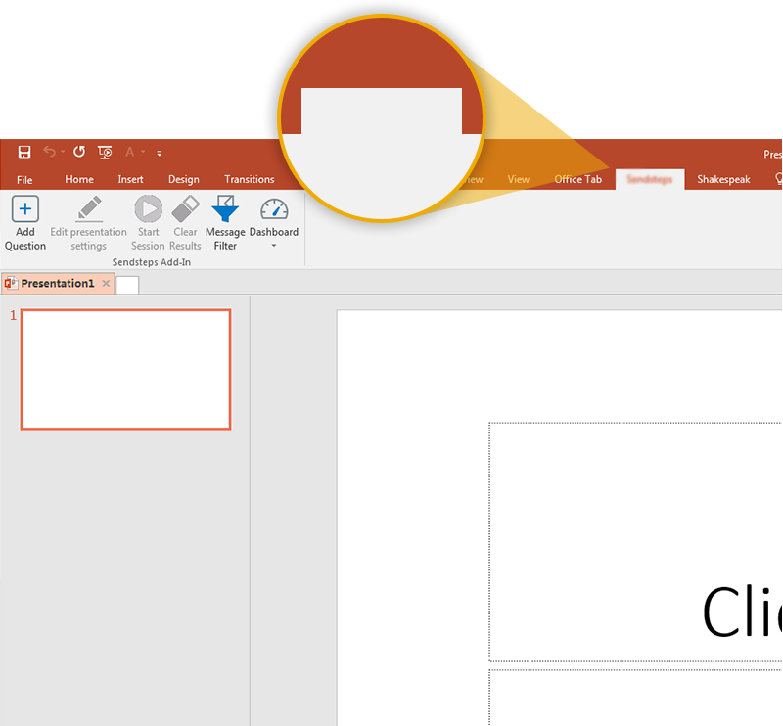

Next step: click on the QUIZZTOTVS tab!
QUIZZTOTVS
Click on the QUIZZTOTVS tab to make your presentation interactive and give your audience a voice.
For more info go to your Dashboard

