Slide 1

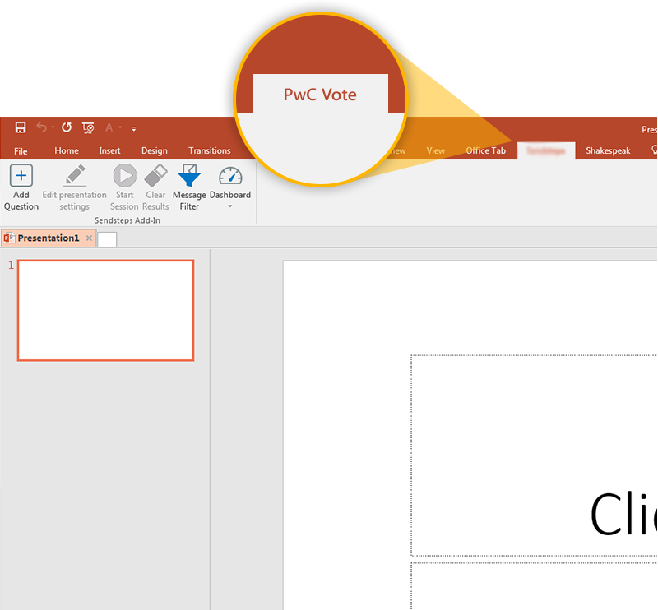

Next step: click on the PwC Vote tab!
Click on the PwC Vote tab to make your presentation interactive and give your audience a voice.
For more info go to your Dashboard

