Slide 1
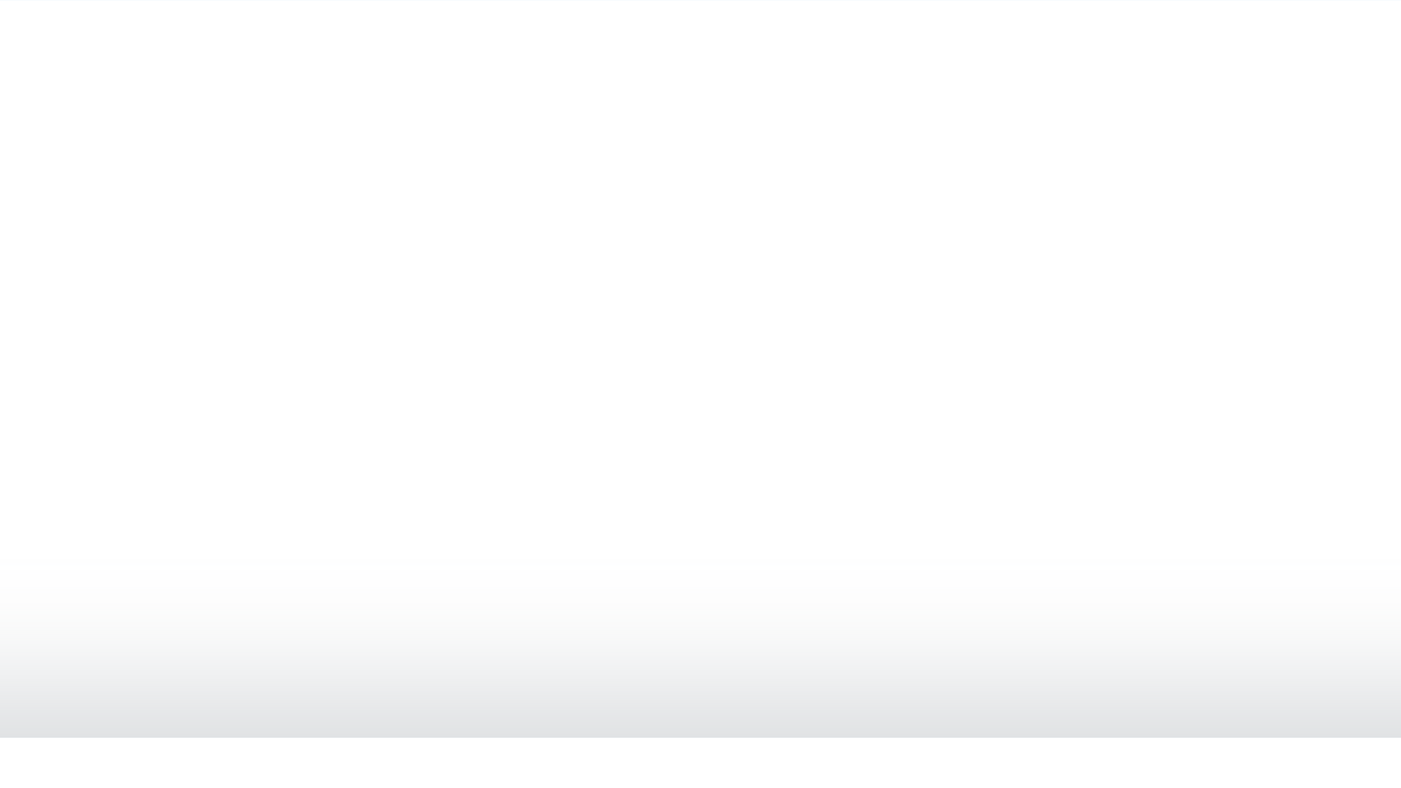
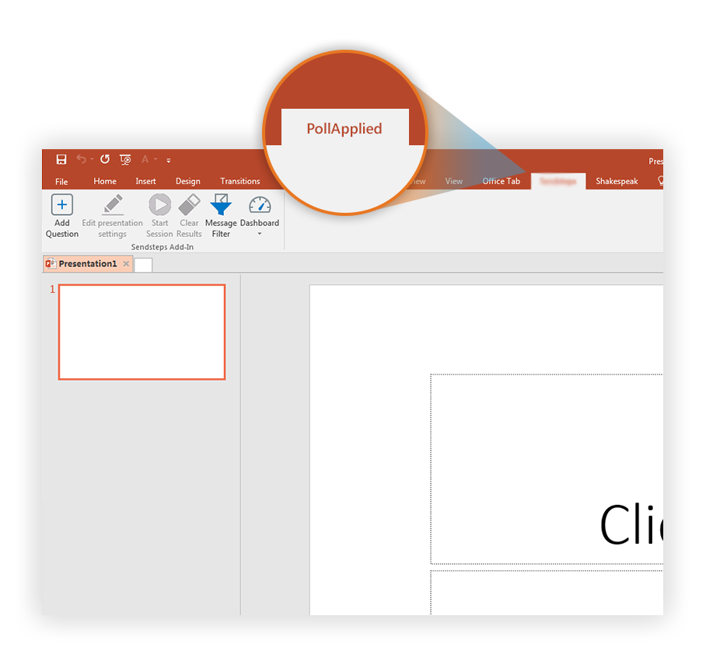

Prepare to vote
Click on the PollApplied tab to make your presentation interactive and give your audience a voice.
For more info go to your Dashboard

