Slide 1

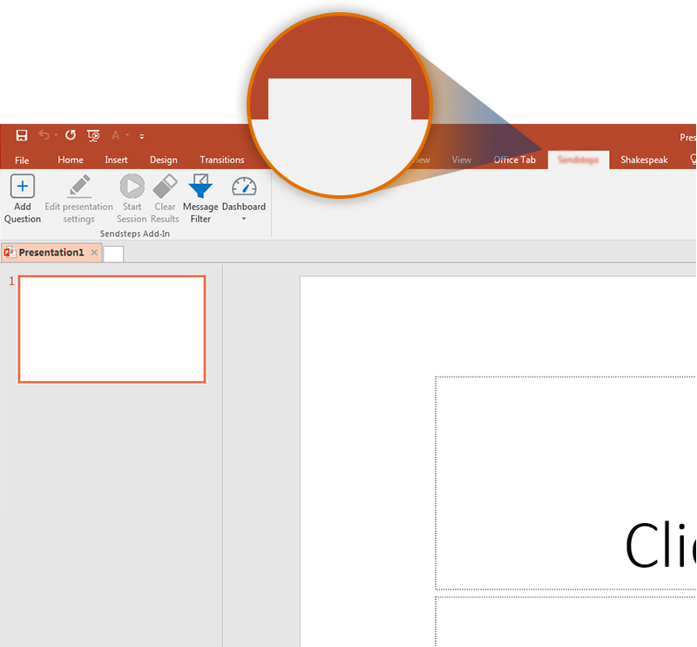
Next step: click on the OGG5 tab!
OGG5
Click on the OGG5 tab to make your presentation interactive and give your audience a voice.
For more info go to your Dashboard

