Slide 1

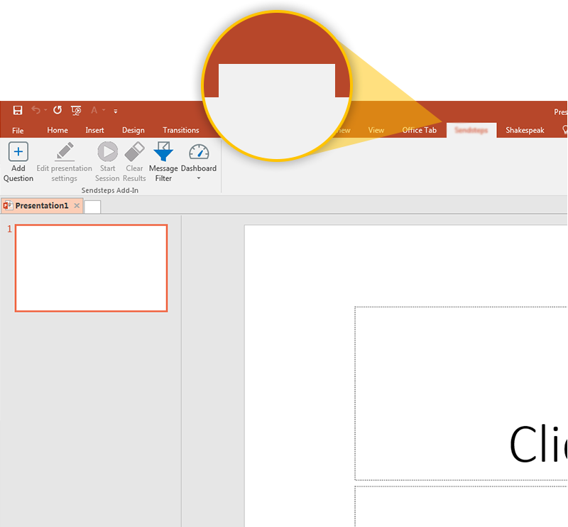
Next step: click on the NS in gesprek tab!
NS in gesprek
Click on the NS in gesprek tab to make your presentation interactive and give your audience a voice.
For more info go to your Dashboard

