Slide 1

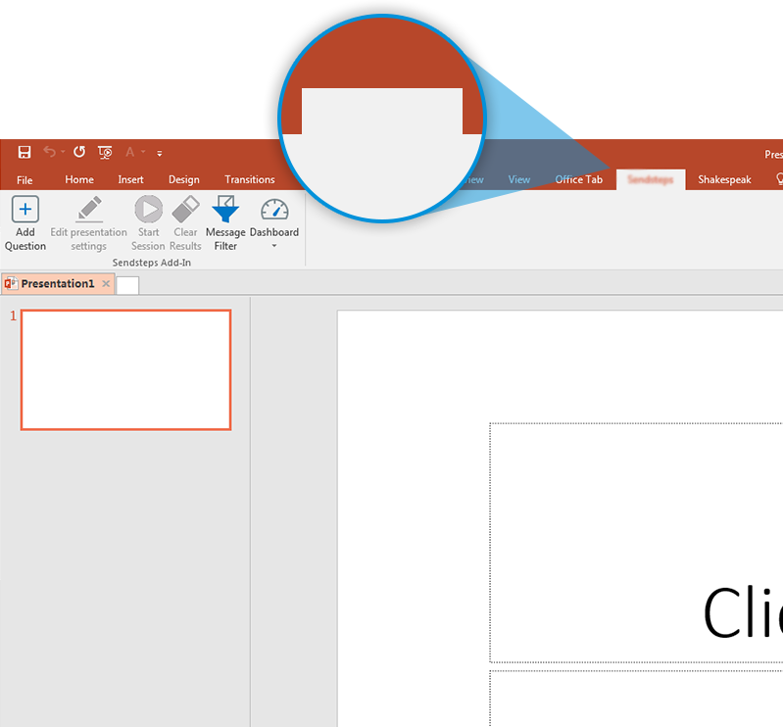

KPMG Vote
Prepare to vote
Next step: click on the KPMG Vote tab!
For more info go to your Dashboard
DO NOT USE THIS PAGE IN YOUR PRESENTATION
The interactive slides have to look different than your default template, this activates your audience. And you and your colleagues recognize interactive slides in presentations.
The response website has the same look and feel as the slide in your PowerPoint presentation.

