Slide 1
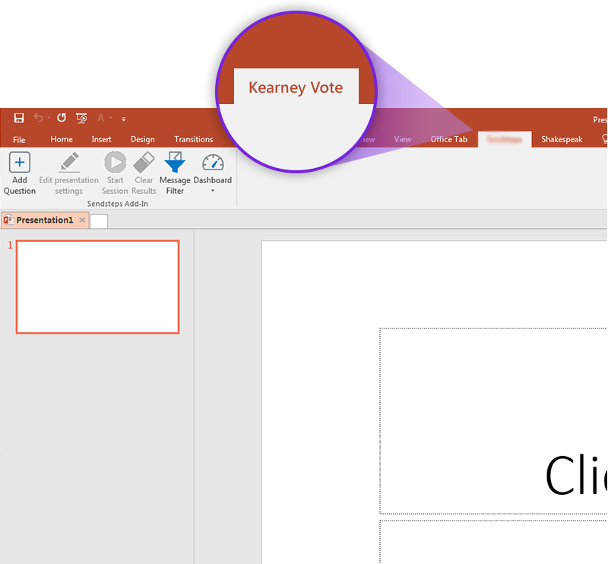

Next step: click on the Kearney Vote tab!
Click on the Kearney Vote tab to make your presentation interactive and give your audience a voice.
For more info go to your Dashboard

