Slide 1
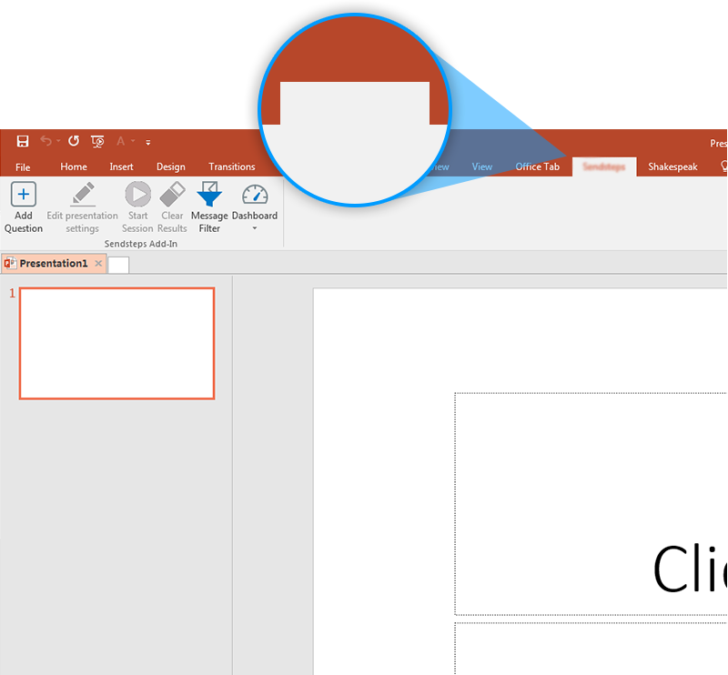

Next step: click on the KLM Vote tab!
KLM Vote
Click on the KLM Vote tab to make your presentation interactive and give your audience a voice.
For more info go to your Dashboard

