Slide 1

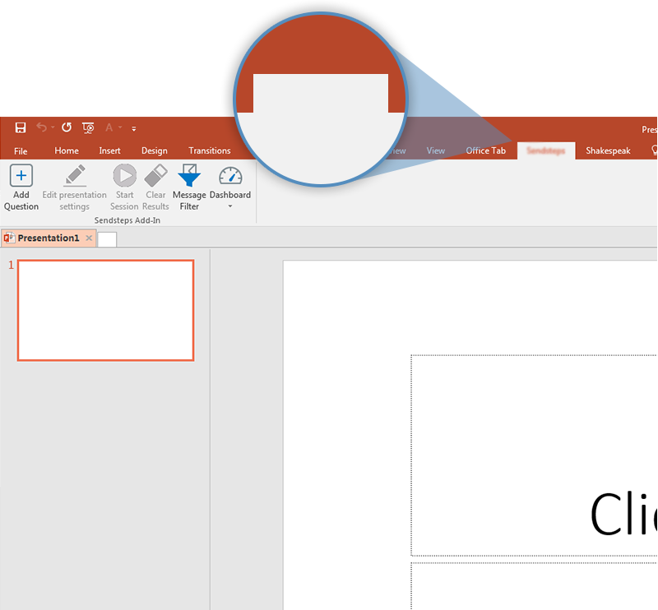
Next step: click on the Houthoff Vote tab!
Houthoff Vote
Click on the Houthoff Vote tab to make your presentation interactive and give your audience a voice.
For more info go to your Dashboard

