Slide 1

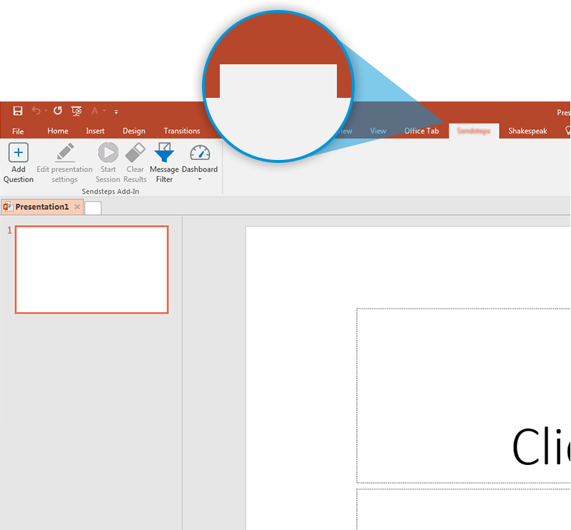
Next step: click on the FC Vote tab
FC Vote
Click on the FC Vote tab to make your presentation interactive and give your audience a voice.
For more info go to your Dashboard

