Slide 1

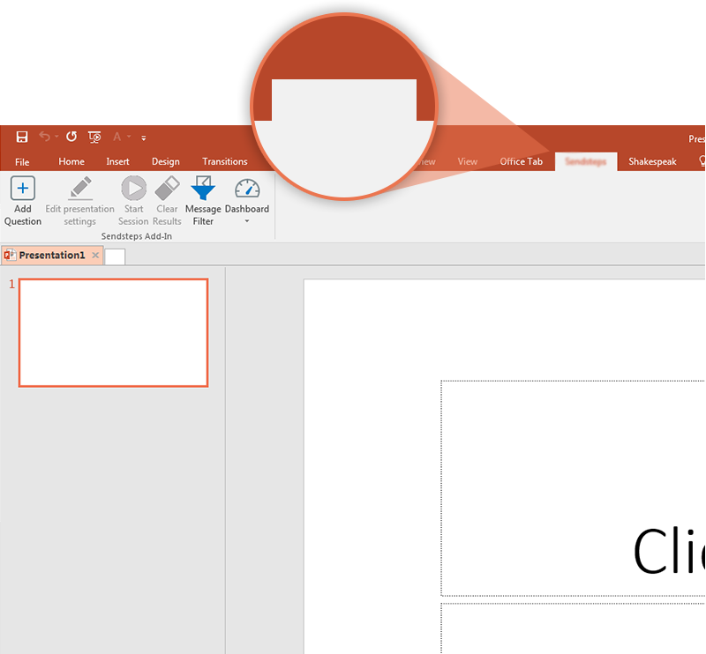

Next step: click on the Eneco Vote tab!
Eneco Vote
Click on the Eneco Vote tab to make your presentation interactive and give your audience a voice.
For more info go to your Dashboard

