Slide 1
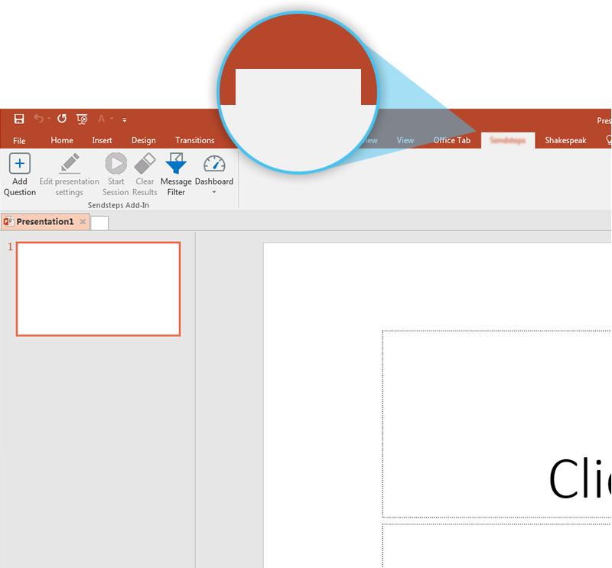

Next step: click on the Deloitte tab!
Deloitte
Click on the Deloitte tab to make your presentation interactive and give your audience a voice.
For more info go to your Dashboard

