Slide 1

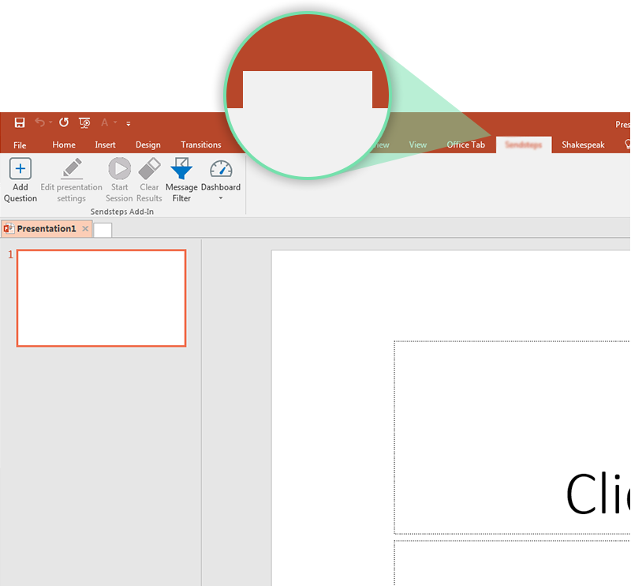

Next step: click on the BCGVote tab!
BCGVote
Click on the BCGVote tab to make your presentation interactive and give your audience a voice.
For more info go to your Dashboard

