Slide 1

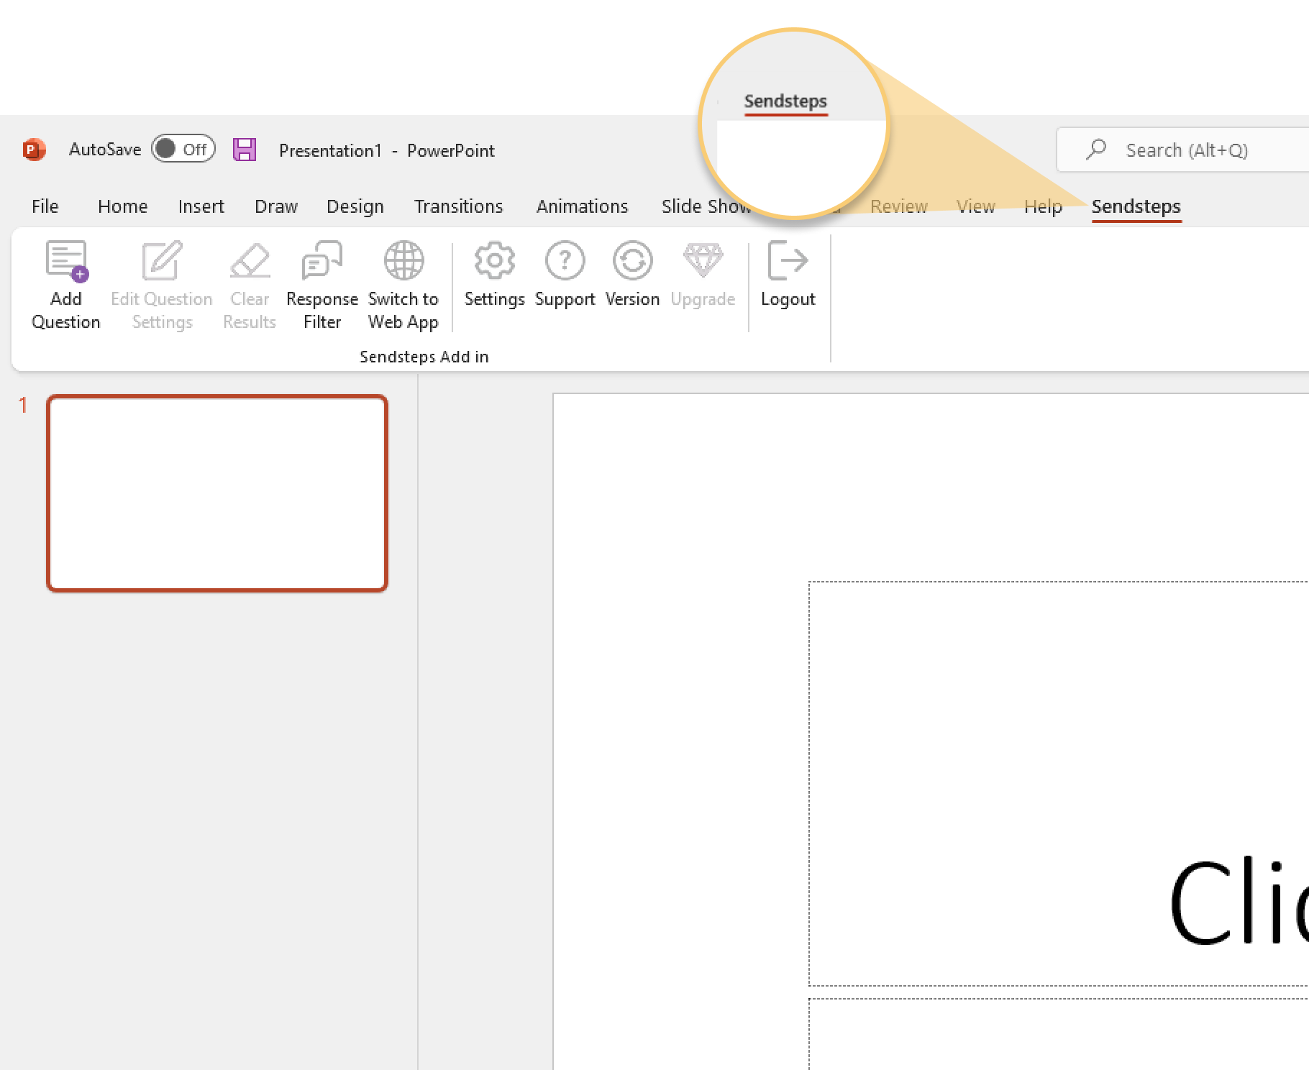

Next step: click on the Sendsteps tab!
Sendsteps
Click on the Sendsteps tab to make your presentation interactive and give your audience a voice.
For more info visit our Help Center

