Slide 1
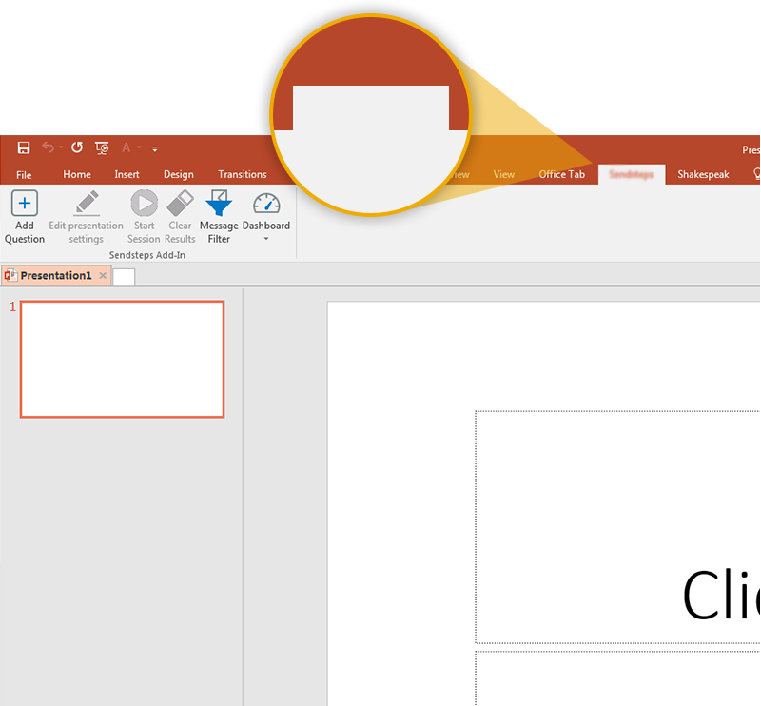

Next step: click on the AZVote tab!
AZVote
Click on the AZVote tab to make your presentation interactive and give your audience a voice.
For more info go to your Dashboard

