Slide 1
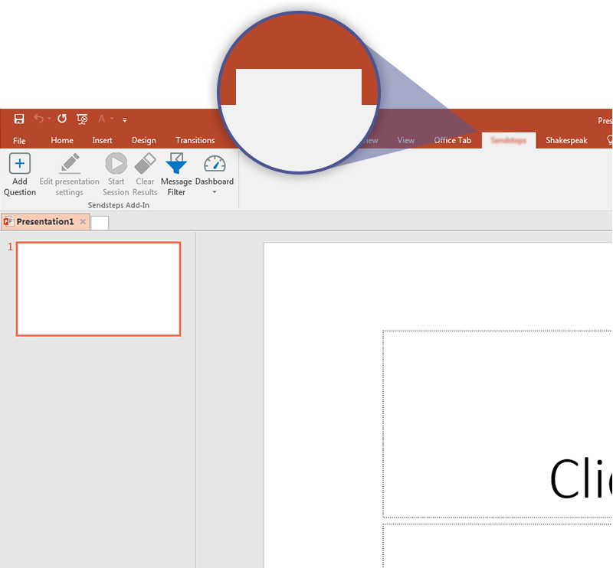

Next step: click on the A.T. Kearney Vote tab!
A.T. Kearney Vote
Click on the A.T. Kearney Vote tab to make your presentation interactive and give your audience a voice.
For more info go to your Dashboard

