Slide 1

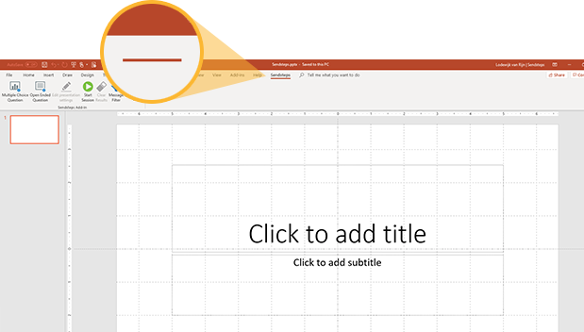

Now you can make an existing or new presentations interactive.
Click on the Sendsteps tab to make your presentation interactive and give your audience a voice.
Sendsteps
For more info go to your Dashboard

